Slide 1
Edge Advanced Mediation
Advanced Mediation

Slide 2
Validating Incoming Request Data

Slide 3
Data Validation Approaches
Simple Validation
Extract Variables in combination with a RaiseFault Policy
Great for JSON, Form Parameters and simple XML structured requests
Format Specific Validation Approaches
JSON
JavaScript policies
XML
XSLT for dynamic references
SOAP
SOAP Message Validation policy
ALL
Java Callout
Notes:
XML – Can also use .XSDs?

Slide 4
XMLToJSON/JSONToXML

Slide 5
XMLToJSON
Converts messages from the extensible markup language (XML) format to JavaScript Object Notation (JSON)
Mostly used for scenarios where APIs are consumed by diverse client apps
The response format can be dynamically set by configuring JSON to XML and XML to JSON policies to execute conditionally
Configuration options available with this policy:
RecognizeNumber - to retain number format instead of strings
RecognizeBoolean - to retain boolean values instead of strings
RecognizeNull - converts empty values to null values
NullValue - indicates what constitues a null value
TextAlwaysAsProperty/TextNodeName - element is converted to a string
AttributeBlockName/AttributePrefix - group values and append prefix to attribute names
OutputPrefix/OutputSuffix - to set prefix and suffix
StripLevels - strip parent levels
TreatAsArray - ensure that values from an XML document are put in a JSON array
NamespaceBlockName/DefaultNamespaceNodeName/NamespaceSeparator - for setting the namespace blocks
Notes:
XML – Can also use .XSDs?

Slide 6
JSONToXML
Converts messages from the JavaScript Object Notation (JSON) to extensible markup language (XML) format
Useful when transforming messages using a custom XSL stylesheet to perform the transformation needed.
The Content-Type must be application/json for this policy to enforce
Configuration options available with this policy:
NamespaceBlockName/DefaultNamespaceNodeName/NamespaceSeparator - serves as the source of a namespace definition in the XML
ObjectRootElementName - specifies the root element name
AttributeBlockName/AttributePrefix - specify when JSON elements are converted into XML attributes (rather than elements)
ArrayRootElementName/ArrayItemElementName - converts a JSON array into a list of XML elements
TextNodeName - converts a JSON property into an XML text node
NullValue - indicates a null value
InvalidCharsReplacement - replaces any JSON elements that produce invalid XML with the string
Notes:
XML – Can also use .XSDs?

Slide 7
XML/JSON Differences
XML has a root element, JSON does not need to
JSON can have an unnamed object or array at the top level
JSON is typed, XML is not
{ "aNumber": 14, "aString": "str", "aBoolean": true, "aNull": null }
<StringOrBoolean>true</StringOrBoolean>
<StringOrNumber>14</StringOrBoolean>
<StringOrNull>null</StringOrNull>
JSON null and null string are different, XML no distinction
"" vs. null
<XmlNull></XmlNull>
XML has attributes, JSON does not
XML has namespaces, JSON does not

Slide 8
XMLToJSON and JSONToXML
XMLToJSON can try to guess data types, but it can be wrong
Configurable: RecognizeNumber, RecognizeBoolean, RecognizeNull
Still may guess wrong (I want ZIP codes to be strings, but they will be made numbers if RecognizeNumber is true)
Has to guess for arrays of objects
0 objects = null (want it to be [ ])
1 object = { ... } (want it to be [ { ... } ]
2 objects = [ { ... }, { ... } ]
JSONToXML
Easier direction
Can use JavaScript/Python to manipulate JSON before converting, or use XSL to manipulate XML after converting

Slide 9
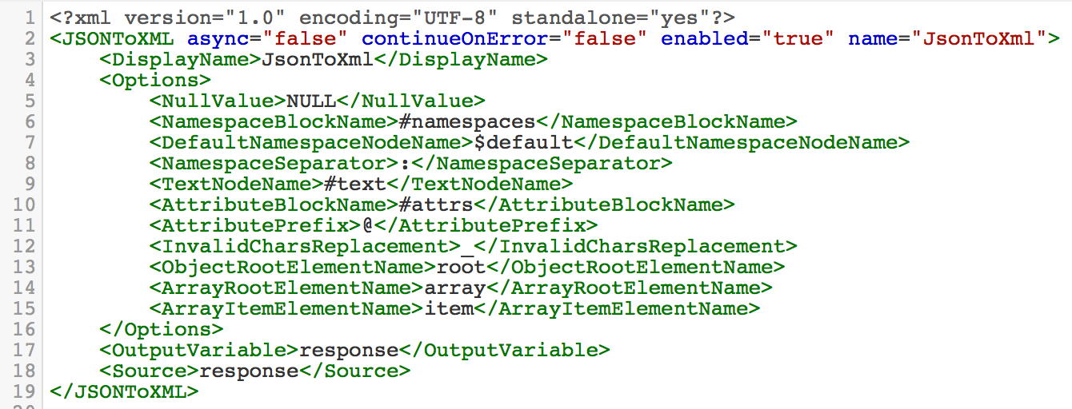
JSONToXML Details
Policy Options
The options for this policy can be used to handle scenarios where JSON does not convert to valid xml or you want to customize the output of the transformation.
Example JSON: { “Some%%%%Name”, “Steve”}
Converted : <Some%%%%Name>Steve</Some%%%%Name> --Invalid XML
You can use <InvalidCharsReplacement>_</InvalidCharsReplacement>:
Customized Conversion: <Some_Name>Steve</Some_Name>
Additional Policy Options
Notes:
http://apigee.com/docs/api-services/content/convert-json-xml

Slide 10
Returning SOAP as a RESTful Response
XSL for cleaning up the SOAP payload or XPath via Extract Variables policy?
Use XPath if you just need a couple of fields.
XSLT (XSL) if you need to extract some value or entity with a dynamic or iterative value
XSLT is generally used for complex XML payload mediations. You can also convert to JSON and then use JSONPath or manipulate via JavaScript

Slide 11
Tips and Tricks for Mediation Policies
Inconsistent conversion of arrays and string fields containing numbers can be incorrectly converted by XMLToJSON and cause issues for app programmers
Can fix this with JavaScript using global search and replace functions:
Step 1: Set RecognizeBoolean, RecognizeNumber, RecognizeNull to true
Step 2: Add ~STR~ to fields that should be strings but may be converted to non-strings ("~STR~" prefix forces elements to look like strings)
Step 3: Add 2 ~ARRAY~ dummy array elements to each array (there will be a minimum of 2 elements per array, forcing conversion to JSON array instead of null or object)
Step 4: If top-level JSON should be an array, use TOPARRAY as the XML root element
Step 5: After XMLToJSON, clean up results with following JavaScript code:

Slide 12
Tips and Tricks for Mediation Policies
// 1) replaces empty strings with null
// 2) removes remaining string specifiers
// 3) removes array placeholders, including trailing commas
// 4) removes array placeholders without trailing commas
// 5) if the return payload is meant to be an array (at the top level), return that
var jsonResponse = context.getVariable("jsonResponse").replace(/"~STR~"/,"null")
.replace(/~STR~/g,"").replace(/"~ARRAY~",/g,"").replace(/"~ARRAY~"/g,"");
var jsonVar = JSON.parse(jsonResponse);
var jsonOut = jsonVar.ROOT;
if (jsonOut.TOPARRAY !== undefined) {
jsonOut = jsonOut.TOPARRAY;
}
response.content = JSON.stringify(jsonOut);

Slide 13
XSLT

Slide 14
XSL Transform Policy
This policy applies custom XSL transformations to XML messages, letting you transform them from XML to another format, such as XML, HTML, or plain text
This policy will transform XML only if the Content-Type header on the message to be transformed is set to XML. For example, text/xml or application/xml
Edge relies on the Saxon XSLT processor, and supports XSLT 1.0 and 2.0
The XSL policy requires two inputs:
The name of an XSLT stylesheet, which contains a set of transformation rules) stored in the API proxy under /resources/xsl directory
The source of the XML to be transformed (typically a request or response message)

Slide 15
XSL Transform Policy
<?xml version="1.0" encoding="UTF-8"?>
<catalog>
<cd>
<title>Empire Burlesque</title>
<artist>Bob Dylan</artist>
<country>USA</country>
<company>Columbia</company>
<price>10.90</price>
<year>1985</year>
</cd>
<cd>
<title>Hide your heart</title>
<artist>Bonnie Tyler</artist>
<country>UK</country>
<company>CBS Records</company>
<price>9.90</price>
<year>1988</year>
</cd>
</catalog>
<?xml version="1.0" encoding="UTF-8"?>
<xsl:stylesheet version="1.0"
xmlns:xsl="http://www.w3.org/1999/XSL/Transform">
<xsl:template match="/">
<collections title="My CD Collection">
<xsl:for-each select="catalog/cd">
<cd>
<title><xsl:value-of select="title" /></title>
<artist><xsl:value-of select="artist" /></artist>
</cd>
</xsl:for-each>
</collections>
</xsl:template>
</xsl:stylesheet>
Input
XSL Template

Slide 16
XSL Transform Policy
<?xml version="1.0" encoding="UTF-8"?>
<collections title="My CD Collection">
<cd>
<title>Empire Burlesque</title>
<artist>Bob Dylan</artist>
</cd>
<cd>
<title>Hide your heart</title>
<artist>Bonnie Tyler</artist>
</cd>
</collections>
Output

Slide 17
THANK YOU

